Slide 1

ONLINE PIZZA ORDER BOOKING SYSTEM
VIJAY KUMAR SEN ( 508897)

Slide 2
Brief on Project
Companies that can deliver pizzas are now accepting orders online through their web sites
This web project is useful for pizza shops to manage their orders, customers’ information, production data and more.
Working with single excel sheet file is complicated and cumbersome to maintain.

Slide 3
We purpose a new automated system with very friendliness environment, by using PHP and MySql technology.
Online Pizza order booking system is web based application enables customers to order their pizza for home delivery.
Administrator to process according to pizza order.

Slide 4
Objectives of Online way
Faster way to try pizza
Free online marketing
Online order taking
Operation cost reduction
Tracking Deliveries
Reduce paper word

Slide 5
Technical Objectives
Sales
Purchase
Payments
Inventory
Secure and Database oriented
Delivery tracking
Search Bill
Notes:
Build a web based system.

Slide 6
Software development phases
System study
Feasibility study
System analysis
System design
Coding
Testing
Implementation
Maintenance

Slide 7
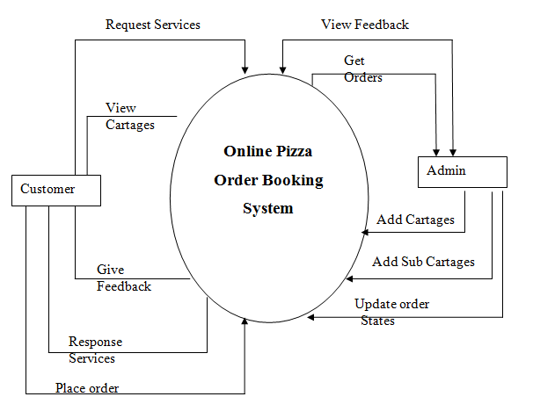
Context Level DFD

Slide 8
ER Diagram
ID
First name
Pin
User ID
ID
Address rd
Address rd
Password
Country
Num
State rd
Email
I
Place
N
Basic rd
Order
Customer
Order
Customer
Last name
I
I
Type
has
Type
Give
Deliver
I
Email
Category id
Email
I
Category
Nmae
Feed back
I
N
Category name
Comments
Add
has
View
Image
Nmae
ID
Cid
N
Personal price
I
I
N
User name
Admin
Add
Sub Category
Medium price
Path
Password
Family
Toppings

Slide 9
Testing
Unit Testing
Integration Testing
System Testing
Field Testing
Acceptance Testing

Slide 10
Verification & Validation
Verification
Are we building the product right?
Validation
Are we building the right product?
Training Needs

Slide 11


